Slide 1
COMPLIANCE
CLUB
MEETING
FEBRUARY 25, 2020
Ario Dehghani
Co-Chair of the Chamber Compliance Club,
Counsel,
Sayenko Kharenko Law firm
ade@sk.ua
Pavlo Bespalov,
Co-Chair of the Chamber Compliance Club,
Counsel,
Philip Morris Ukraine, Caucasus, and Moldova
Pavlo.Bespalov@pmi.com
Joseph Murphy,
Director of Public Policy, Society of Corporate
Compliance and Ethics
Skype: Joe.Murphy.61830
jemurphy5730@gmail.com

Slide 2
Application of 11 Elements of Effective Compliance Program – a General State of Corporate Compliance in Ukraine?
SURVEY RESULTS

Slide 3
General Information about respondents

Slide 4
SURVEY RESULTS
1 Analysis and Remediation of Underlying Misconduct

Slide 5
1 Analysis and Remediation of Underlying Misconduct

Slide 6
SURVEY RESULTS
2 Senior and Middle Management

Slide 7
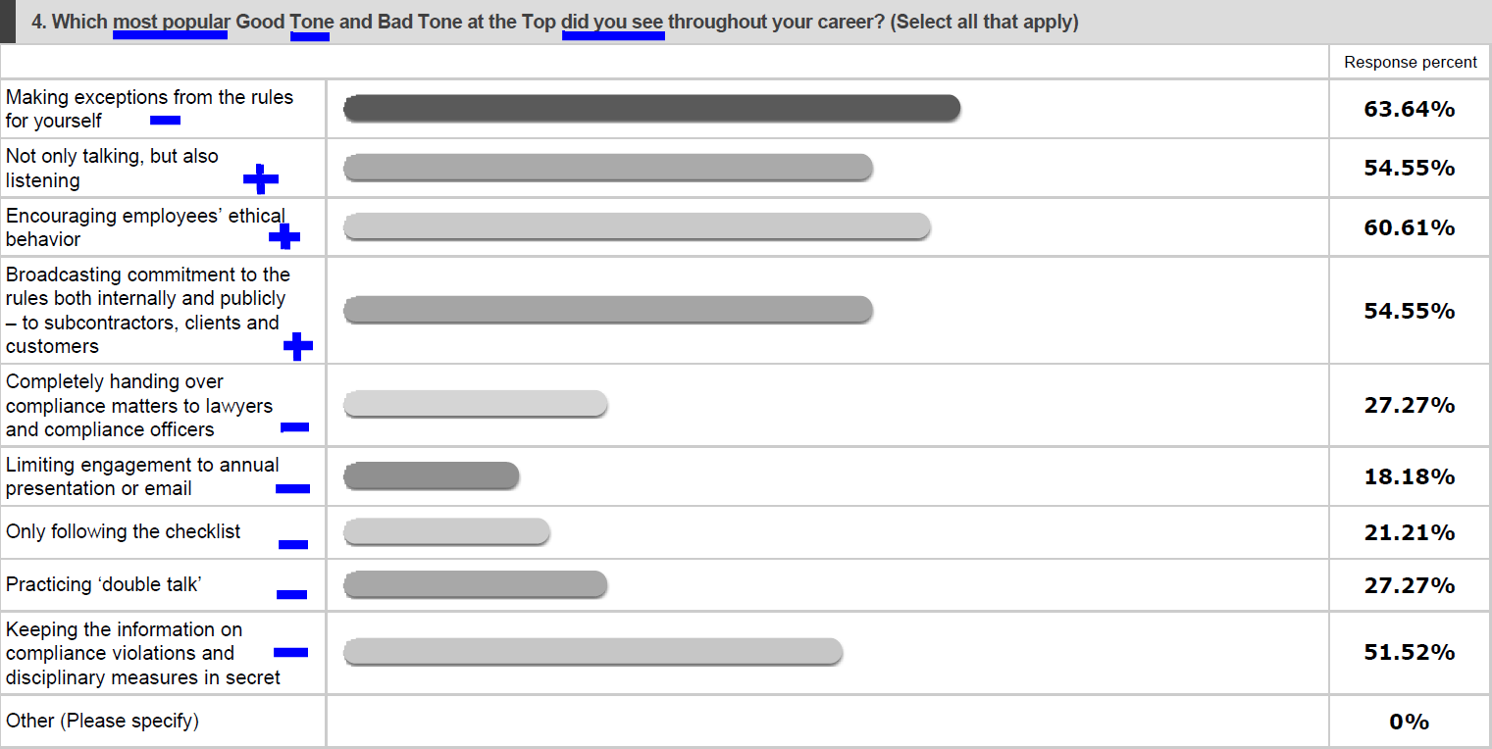
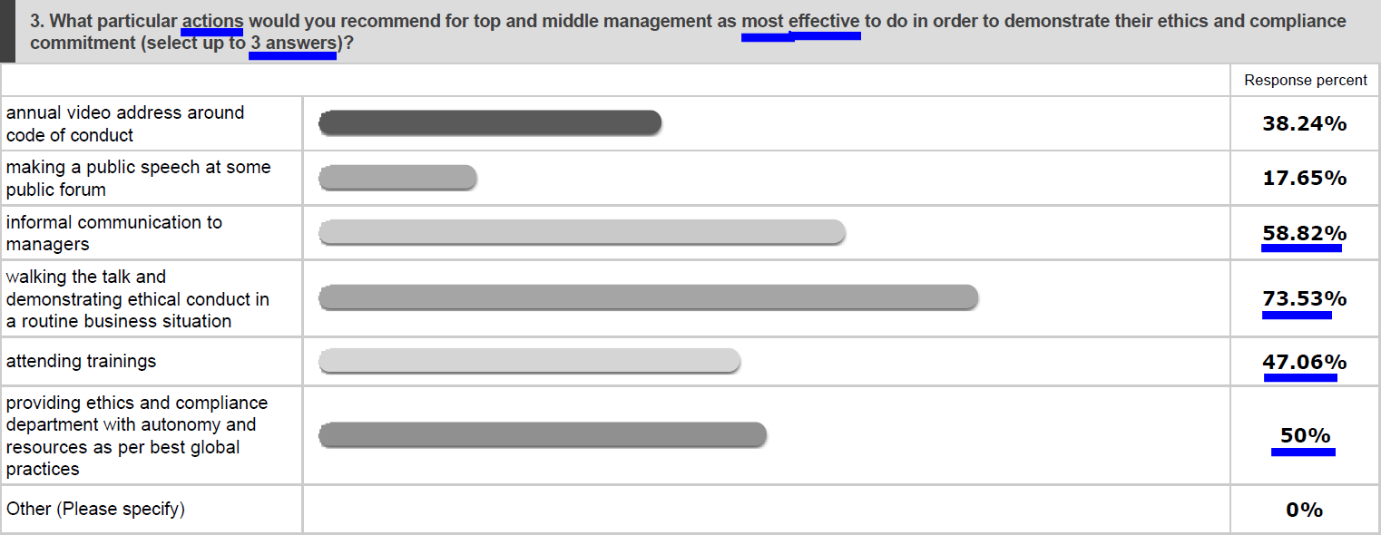
2 Senior and Middle Management

Slide 8
SURVEY RESULTS
3 Autonomy and Resources

Slide 9
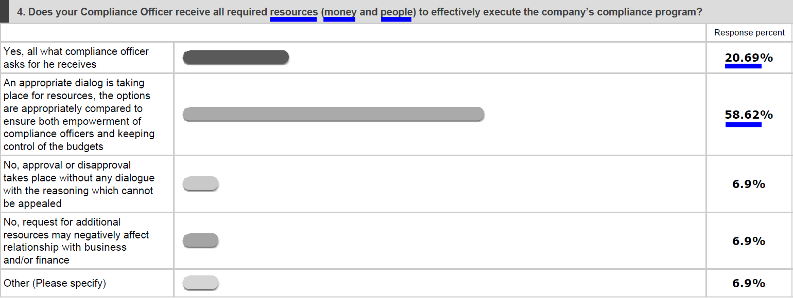
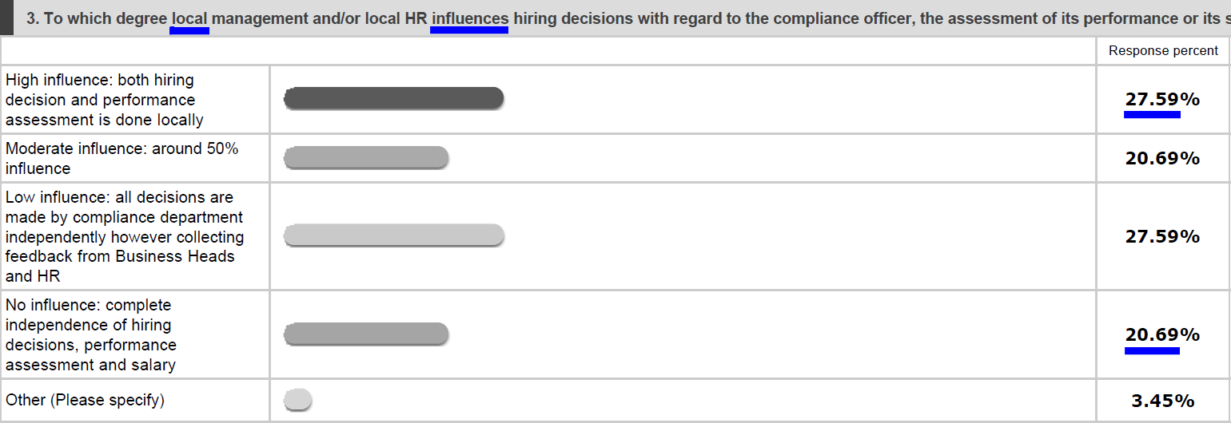
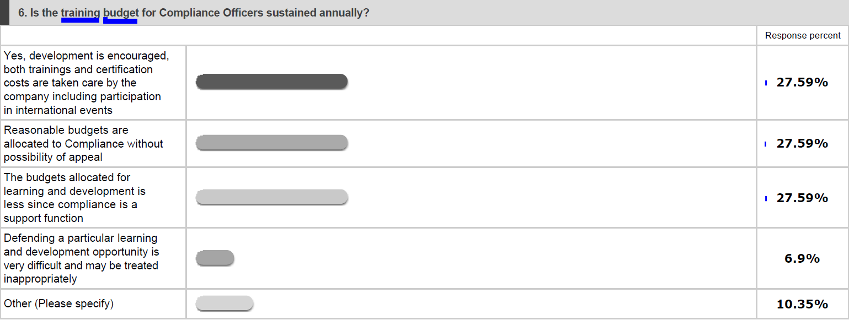
3 Autonomy and Resources

Slide 10
SURVEY RESULTS
4 Policies and Procedures

Slide 11
4 Policies and Procedures

Slide 12
4 Policies and Procedures

Slide 13
SURVEY RESULTS
5 Risk assessment

Slide 14
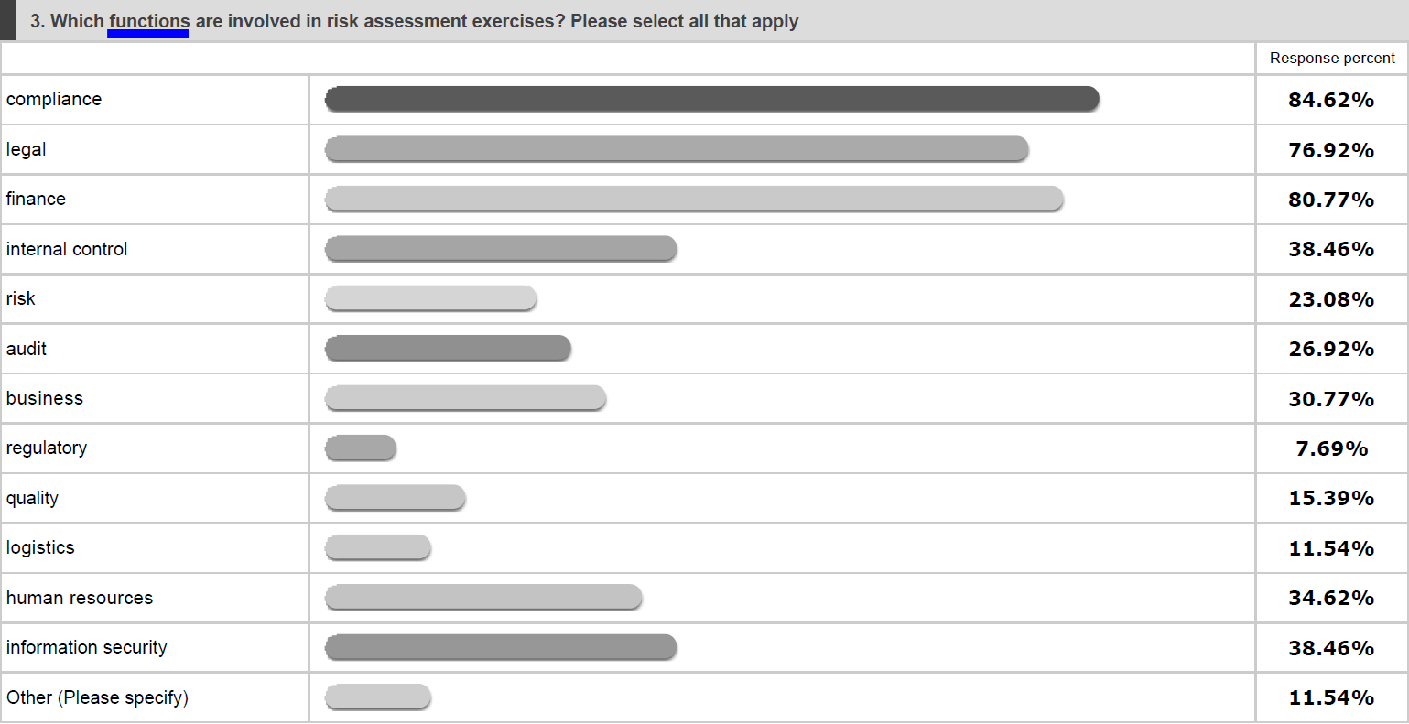
5 Risk assessment

Slide 15
SURVEY RESULTS
6 Training and Communication

Slide 16
6 Training and Communication

Slide 17
6 Training and Communication

Slide 18
SURVEY RESULTS
7 Confidential Reporting and Investigation

Slide 19
7 Confidential Reporting and Investigation

Slide 20
SURVEY RESULTS
8 Incentives and Disciplinary Measures

Slide 21
8 Incentives and Disciplinary Measures

Slide 22
SURVEY RESULTS
9 Continuous Improvement, Periodic Testing and Review

Slide 23
9 Continuous Improvement, Periodic Testing and Review

Slide 24
SURVEY RESULTS
10 Third parties’ check

Slide 25
10 Third parties’ check

Slide 26
Thank you for your attention!
COMPLIANCE
CLUB
MEETING

